Slide 1
Introduction Practical Session 3: Image processing 1
Sebastian Amador Sanchez
sebastian.amador.sanchez@vub.be
Anass Hamdi
anass.hamdi@vub.be

Slide 2
Content
Usage of SimpleITK
Introduction to 3D Slicer
Practical session 3

Slide 3
Usage of SimpleITK

Slide 4

A simplified version of ITK (Insight Tool Kit) for scientific image processing, segmentation, and registration
Ideal for medical imaging: X-rays, CT, PET, MRI, and US
Available in Python:
pip install SimpleITK | conda install simpleitk

Slide 5
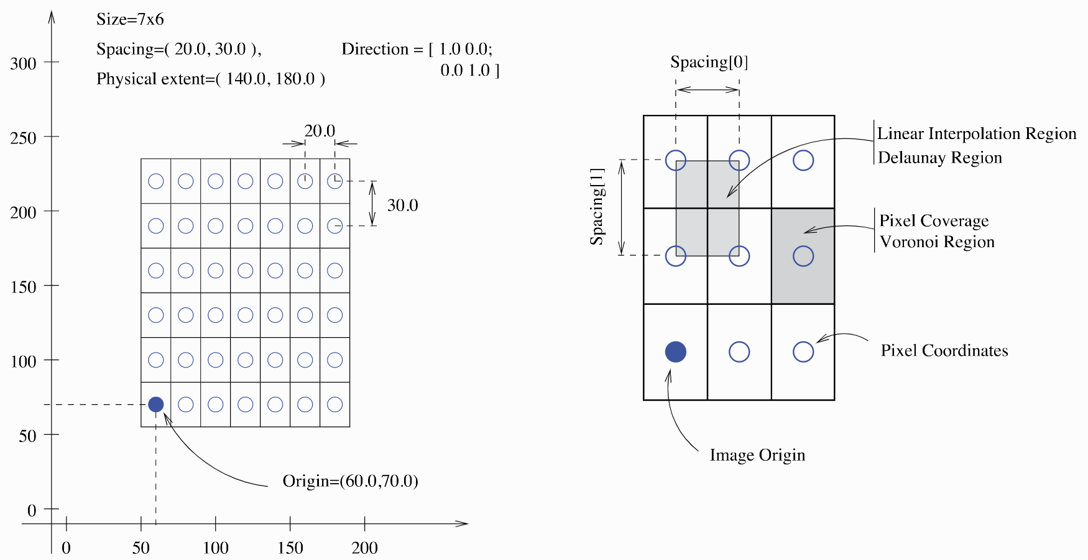
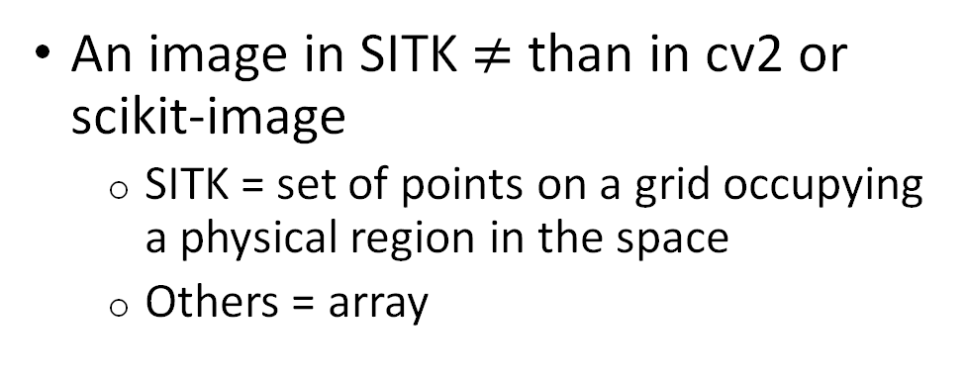
Image fundamentals
An image in SITK $≠$ than in cv2 or scikit-image
SITK = set of points on a grid occupying a physical region in the space
Others = array
SITK takes into account:
Pixel/voxel spacing information
Location in the physical space

Slide 6
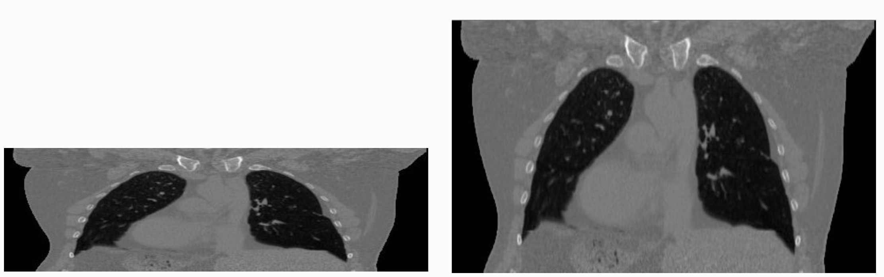
Image spacing:
256
256
512
512
Image spacing = (1.0, 1.0)
Image spacing = (0.97, 2.0)

Slide 7
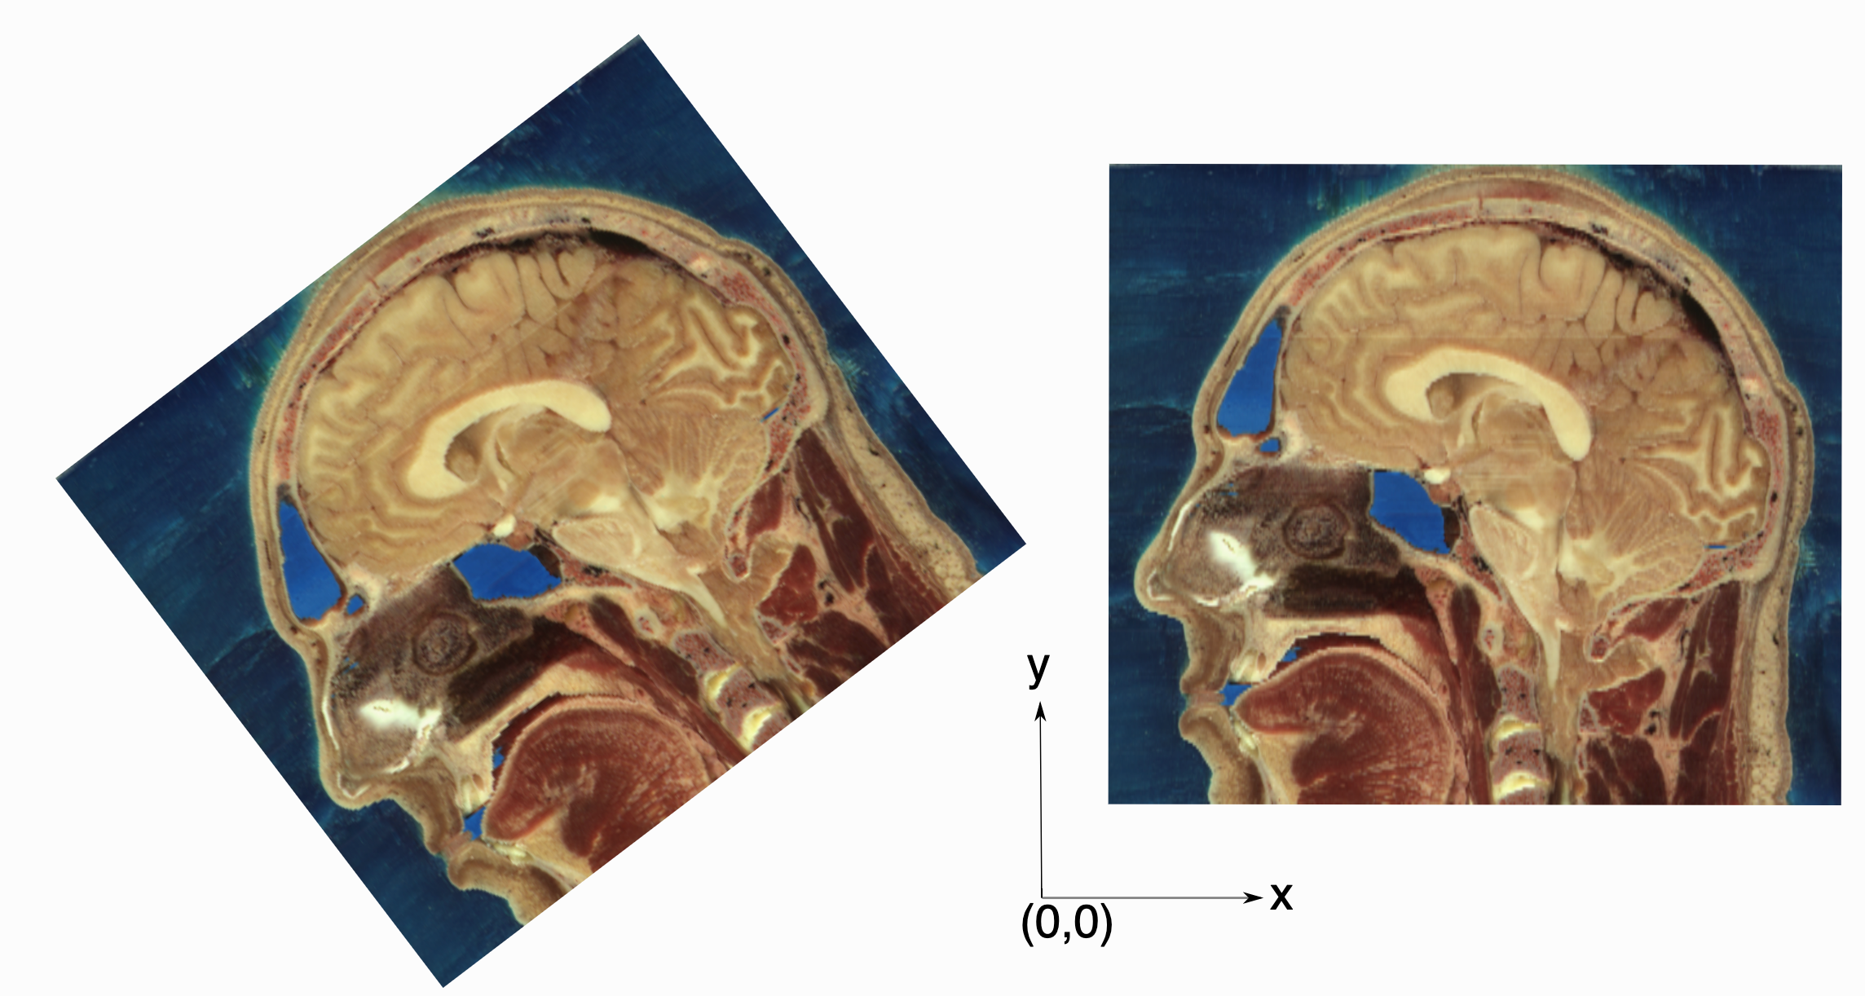
Image origin and direction:
Image origin = (-136.3, -20.5)
Orientation matrix = (0.7, -0.7, 0.7, -0.7)
Image origin = (16.9, 21.4)
Orientation matrix = (1, 0, 0, 1)

Slide 8
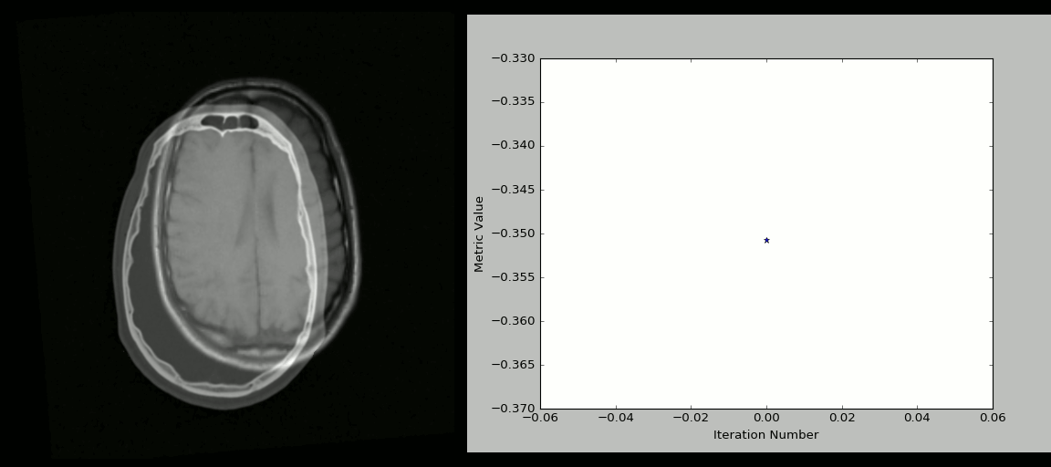
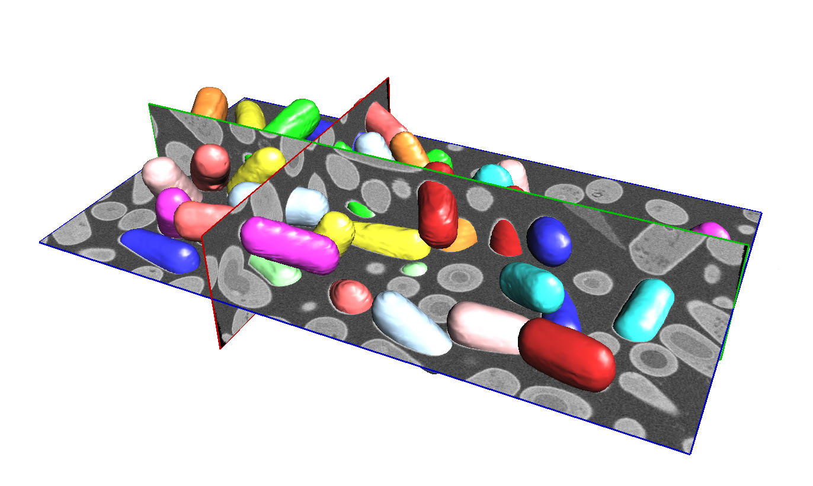
Image registration:
Image segmentation:

Slide 9
How to read an image?
import SimpleITK as sitk
image = sitk.ReadImage(path_to_image)

Slide 10
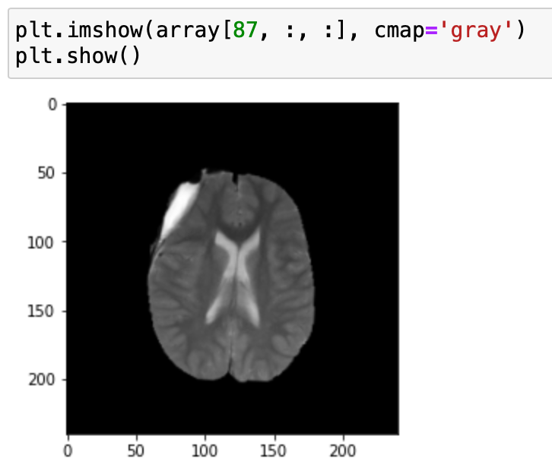
Conversion between SimpleITK and NumPy
From SimpleITK to NumPy:
image = sitk.ReadImage(path_to_image)
array = sitk.GetArrayFromImage(image)
array.shape -> (155, 240, 240)

Slide 11
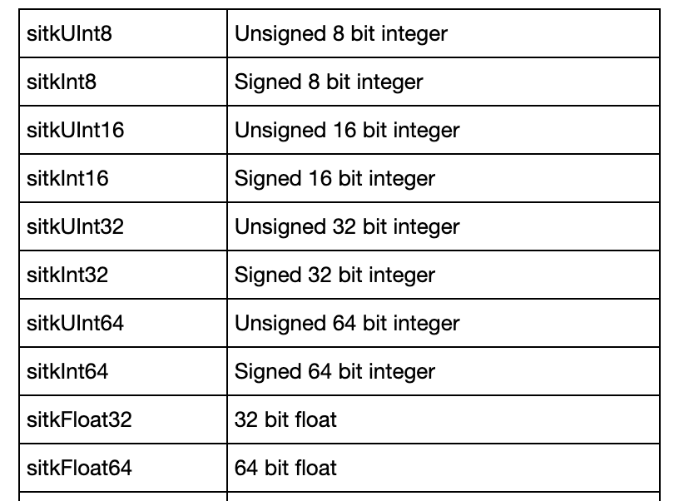
Reading an image
Multiple image formats:
Standard ones: .jpeg, .png, .tiff, etc
Medical ones: .mha, .nii, .dcm
image = sitk.ReadImage(path_to_image)
Default = '16-bit signed integer’
image = sitk.ReadImage(path_to_image, sitk.sitkUInt8)

Slide 12
Introduction to 3D Slicer

Slide 13

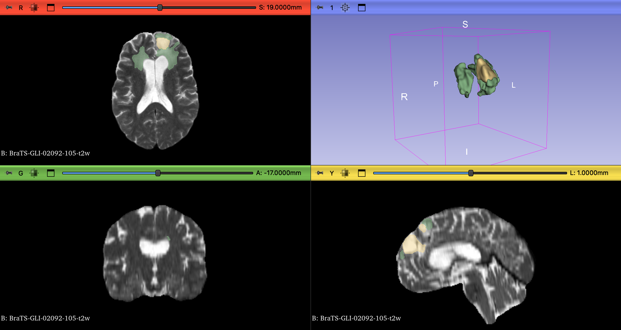
3D Slicer
3D medical image viewer
Analyze medical images and their metadata
Create 3D reconstructions of segmentations
Modules available for medical image analysis:
Registration
Segmentation
…

Slide 14
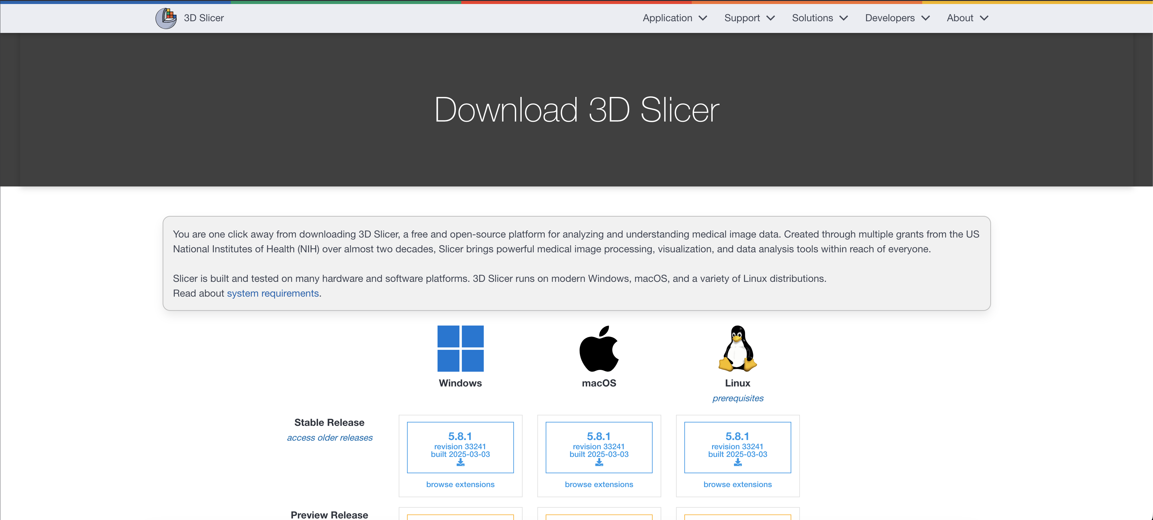
https://download.slicer.org/

Slide 15
How to use for the exercises
Easy and quick way for viewing slices in all 3 orientations at once
Use 3D Slicer to select a suitable slice to plot 2D results for exercises
Alternative to 3D Slicer (or any 3D image viewer): Manually plot slices in python with matplotlib → slow and time-consuming

Slide 16
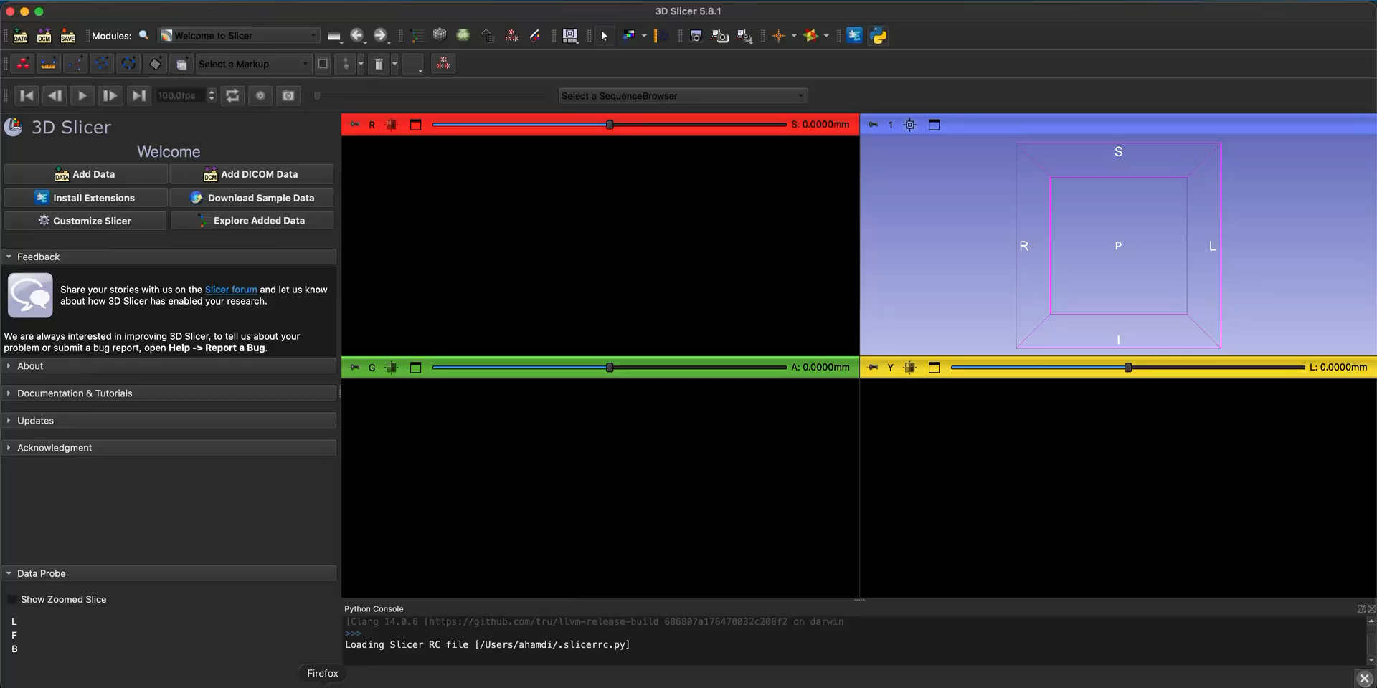
Example
Data probe in bottom left contains voxel information:
(Location in physical space)
(Intensity value)
Location in image space
Use image space location to choose slice for exercises
Remember: NumPy inverts the axis order! (XYZ → ZYX)

Slide 17
Practical Session 3
Image enhancement and denoising

Slide 18
Image enhancement & denoising
Image histogram
Image denoising:
Mean, median, and Gaussian filtering
Image denoising:
Homomorphic Unsharp Masking filter
Grading:
10 points code/figures
10 points oral evaluation

Slide 19
Exercise 1: Image histogram
Linear stretching *
Histogram equalization *
CLAHE (skimage implementation)

Slide 20
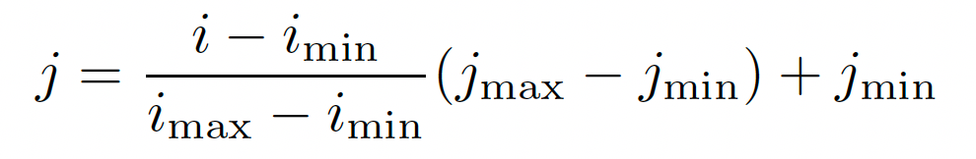
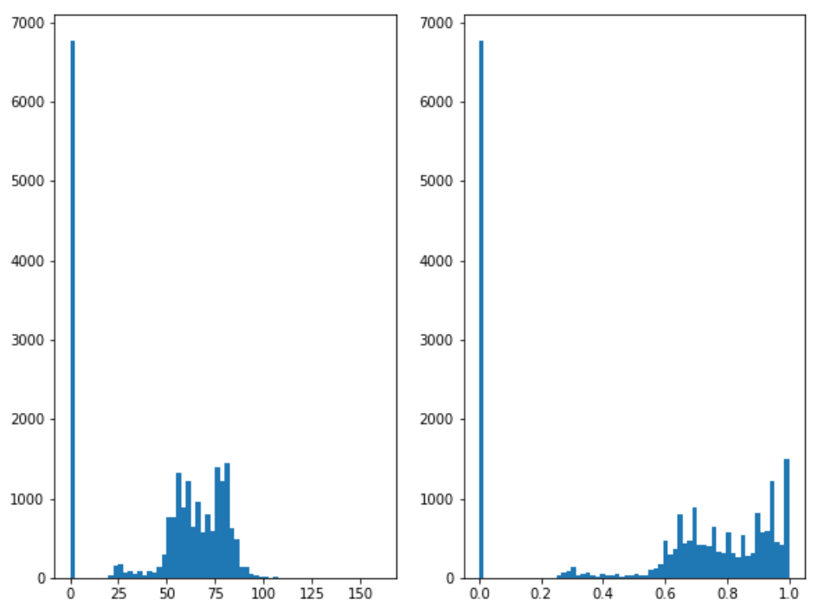
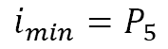
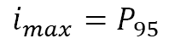
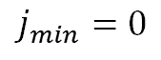
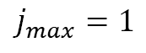
Exercise 1: Image histogram
Linear stretching *
Original
Linear stretched
$j_{min}=0$
$j_{max}=1$
$i_{min}=P_{5}$
$i_{max}=P_{95}$

Slide 21
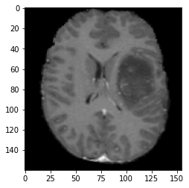
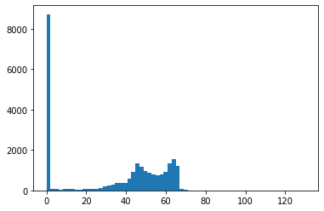
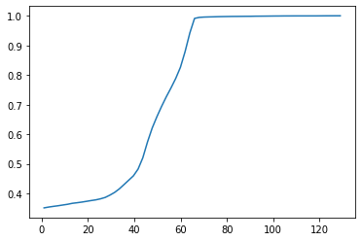
Exercise 1: Image histogram
Histogram equalization*
Scaled cumulative
distribution
Bins centers

Slide 22
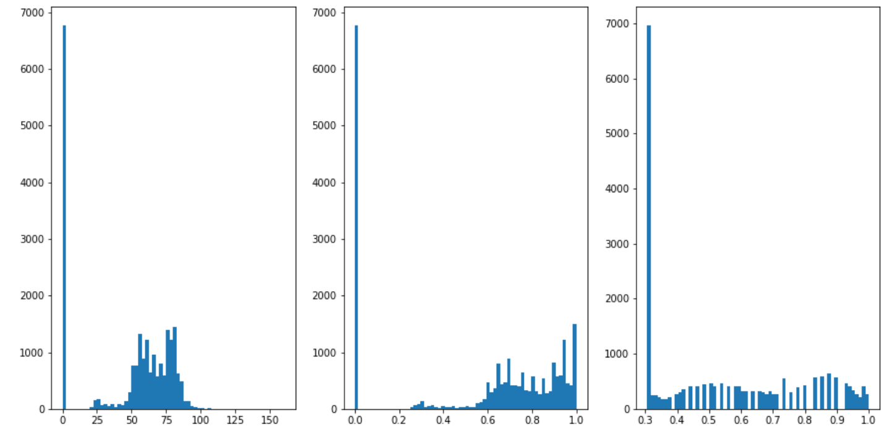
Exercise 1: Image histogram
Histogram equalization*
Original
Equalized
Interpolate

Slide 23
Exercise 1: Image histogram
To report:
A comparison between approaches.

Slide 24
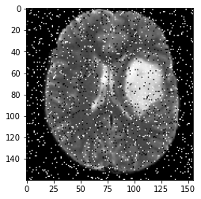

Exercise 2: Image denoising
Mean filter *
Gaussian filter
Median filter

Slide 25
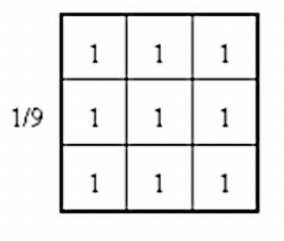
Exercise 2: Image denoising
Mean filter *
Convolve

Slide 26
Exercise 2: Image denoising
To report:
The filtered images, noise filtered, remaining noise, and edge images.
The root mean squared error (RMSE) between filtered and original images.

Slide 27
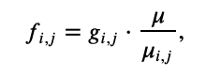
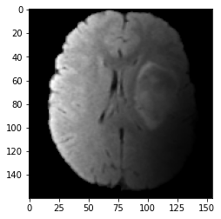
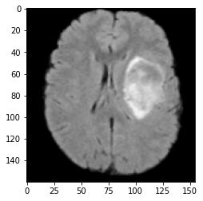
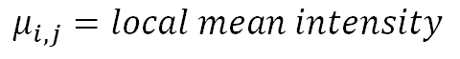
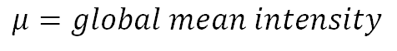
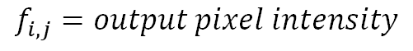
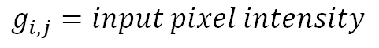
Exercise 3: HUM algorithm
Remove bias noise
$$f_{i, j}=output pixel intensity$$
$$μ=global mean intensity$$
$$g_{i, j}=input pixel intensity$$
$$μ_{i,j}=local mean intensity$$

Slide 28
Exercise 3: HUM algorithm
Direct implementation *:
Get mean intensity (global)
Define a window of 20 x 20 x 20
Get mean intensity (local)
Compute HUM
Move the window, and repeat
20
20
20

Slide 29
Exercise 3: HUM algorithm
Pad image *:
Pad the image
Get mean intensity (global)
Define a window of 20 x 20 x 20
Get mean intensity (local)
Compute HUM
Move the window, and repeat
20
20
20

Slide 30
Exercise 3: HUM algorithm
Pad + threshold *:
Pad the image
Filter pixels below a threshold (10)
Get mean intensity (global)
Define a window of 20 x 20 x 20
Get mean intensity (local)
Compute HUM
Move the window, and repeat
20
20
20

Slide 31
Exercise 3: HUM algorithm
To report:
Filtered images
NRMSE and SSIM between filtered and original images

